Slide 1
Some useful (I hope) stuff for pion XS
Elena Gramellini

Slide 2
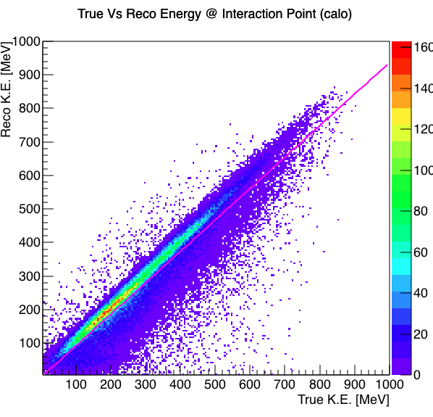
Reconstruction Vs True Energy @ Interaction point (calo)
The plot starts at 5 MeV cause truth has a bunch of stuff at 0.
If I find that the true interaction energy is < 5 MeV, I take the second to last point. But if the second to last point is also second to last point, then I just take the hit.
Reco Energy @ Interaction Point =
√(WCMom² + mass_{π}²)
- flatEnloss
- Σ dE/dx*pitch

Slide 3
Linear regression on this curve: how good we reco?
Reco = m True + q
q = -1.720 MeV
m = 0.94 R²=0.87
Data manipulation for fit:
No Negative KE
No True KE < 5 MeV

Slide 4
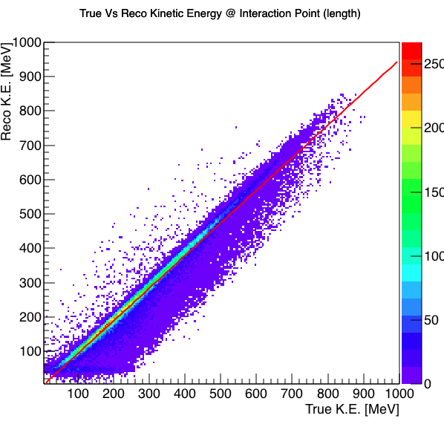
Reconstruction Vs True Energy @ Interaction point (length)
Reco Energy @ Interaction Point =
√(WCMom² + mass_{π}²)
- flatEnloss
- Reco length * 2.1 MeV/cm

Slide 5
Linear regression on this curve: how good we reco?
Reco = m True + q
q = -1.26 MeV
m = 0.95 R²=0.92
Data manipulation for fit:
No Negative KE
No True KE < 5 MeV
Notes:
R2 = 1 - mean(Sum of Squared Error)/variance

Slide 6
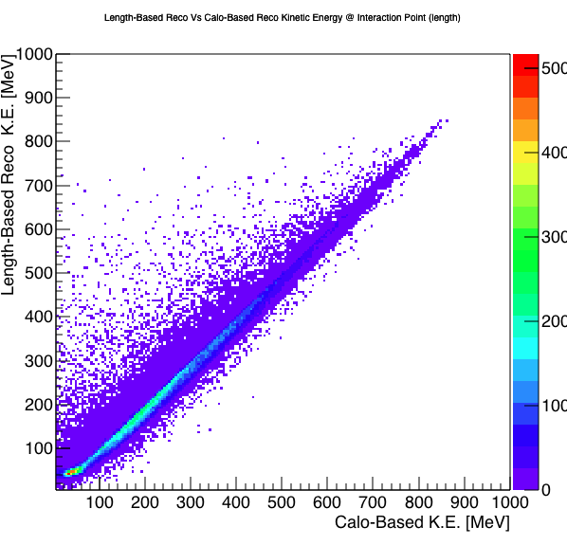
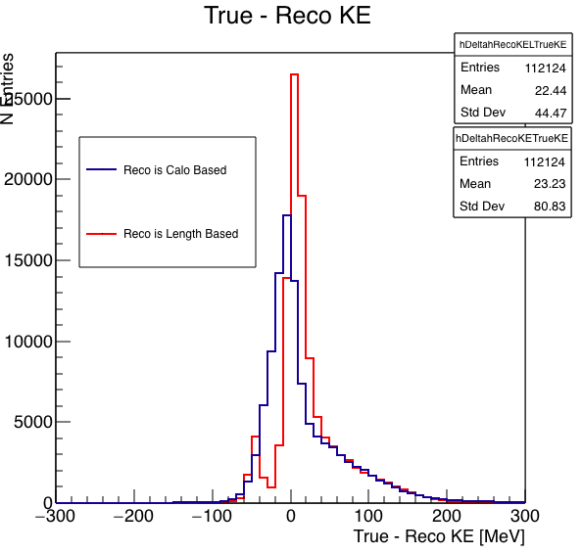
True-Reco Calo True-Reco Length-based Calo

Slide 7
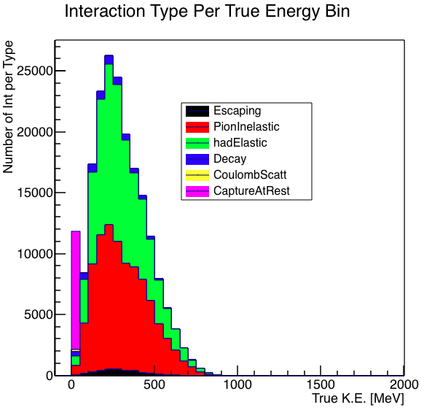
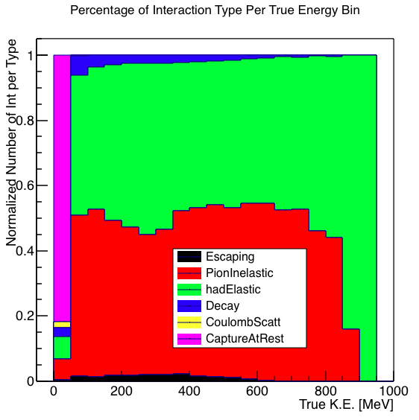
True Interaction composition

Slide 8
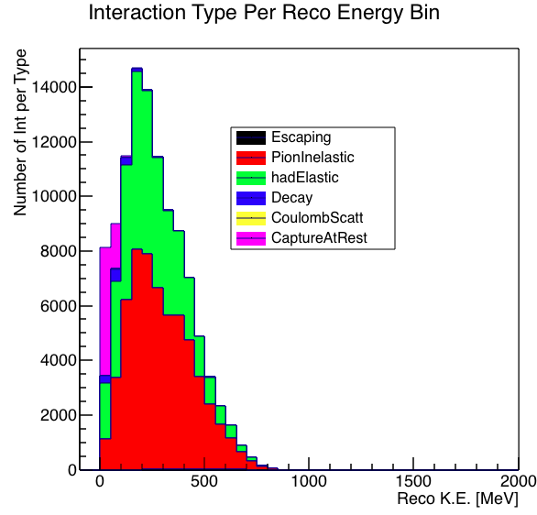
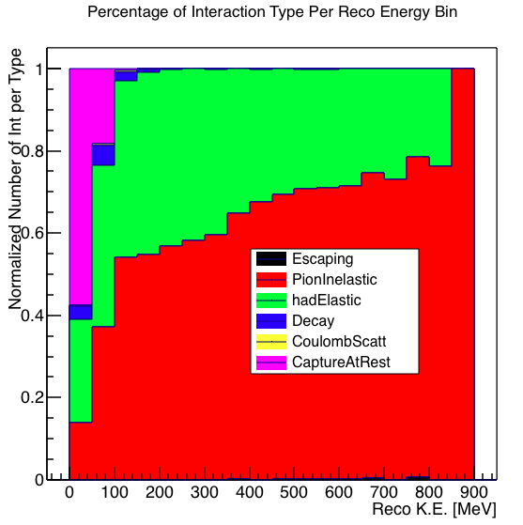
Reco Interaction composition

Slide 9
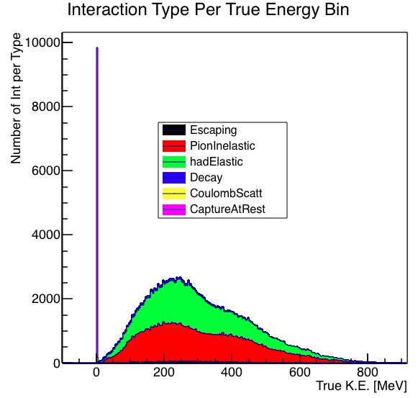
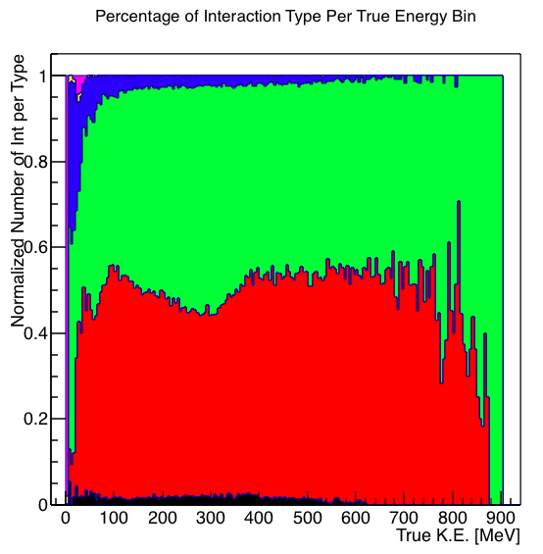
True Interaction composition finer binning

Slide 10
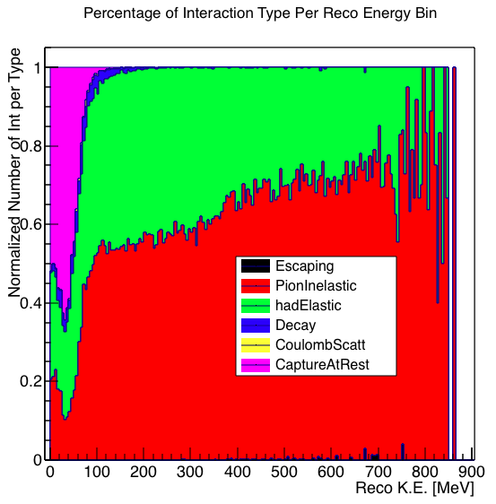
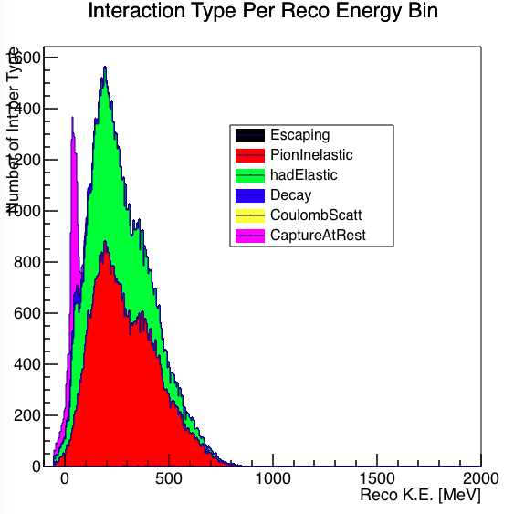
Reco Interaction composition finer binning

